Slide 1
Least Common Multiple(LCM)
By: Omar Hany Hassan Mahmoud
Id:224781

Slide 2
Transform&Conquer
Transform & Conquer is usually used when the given problem is too complicated to be solved directly or there is a simpler way to solve it. The technique consists of three ways of being applied
Instance simplification
Problem reduction
Representation change:
We will only be talking about problem reduction in this powerpoint

Slide 3
Problem Reduction
The idea behind this technique is to transform the given problem into another one that’s easier to solve either by turning it into a different form or using an existing algortithm that you already know and modifying it to apply it to the given problem

Slide 4
LCM & GCD
Least common Multiple or LCM is the smallest positive integre that is divisible by the two given numbers, in arithmetic it’s usually written like this Lcm(a,b)
Example:
Lcm(4,6)
Multiples of 4:
4,8,12,16,20,24,28,32,36,………….
Multiples of 6:
6,12,18,24,30,36,……………..
The common multiples:
12,24,36
After listing all the common multiples and form there we choose the smallest number hence the name Least common multiple in this case the answer would be : 12

Slide 5
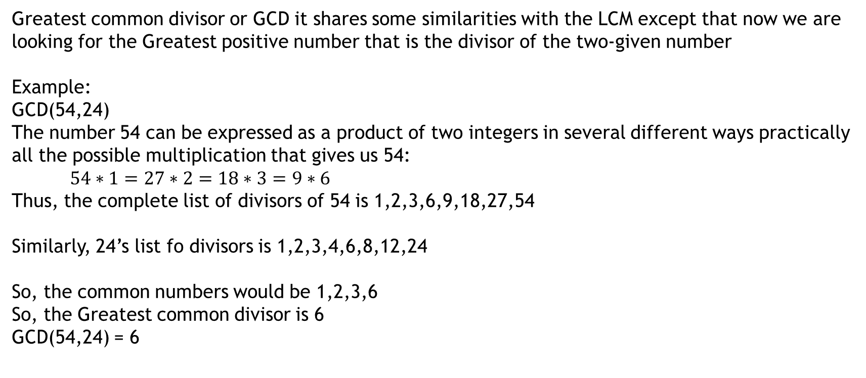
LCM & GCD
Greatest common divisor or GCD it shares some similarities with the LCM except that now we are looking for the Greatest positive number that is the divisor of the two-given number
Example:
GCD(54,24)
The number 54 can be expressed as a product of two integers in several different ways practically all the possible multiplication that gives us 54:
$54∗1=27∗2=18∗3=9∗6$
Thus, the complete list of divisors of 54 is 1,2,3,6,9,18,27,54
Similarly, 24’s list fo divisors is 1,2,3,4,6,8,12,24
So, the common numbers would be 1,2,3,6
So, the Greatest common divisor is 6
GCD(54,24) = 6

Slide 6
LCM & GCD
The way GCD works is by using something called Euclid’s algorithm it works in the following way :
def GCD(a, b):
if b == 0:
return a
return GCD(b, a % b)
Pseudo code:
while b is not 0:
temp = b
b = a mod b
a = temp
return a

Slide 7
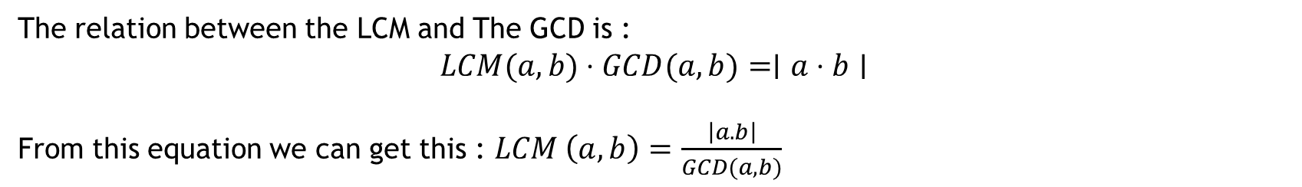
The relation between LCM & GCD
The relation between the LCM and The GCD is :$\text{​}$ $$LCM(a,b)⋅GCD(a,b)=∣a⋅b∣$$
From this equation we can get this : $LCM \left(a,b\right)=\frac{\left|a.b\right|}{GCD(a,b)}$

Slide 8
LCM using problem reduction
def GCD(a, b):
if b == 0:
return a
return GCD(b, a % b)
def LCM(a , b):
x=GCD(a,b)
return (a*b)/x
print(LCM(15, 20))
The number returned from this should be 60
The way it works is that the number returned by the GCD is 5
And then by applying the rule that LCM (a,b) = a*b / GCD(a,b)

Slide 9
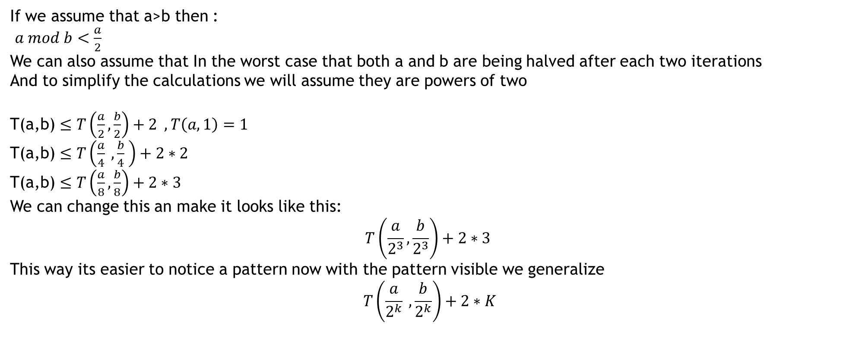
Analysis
If we assume that a>b then :
$a mod b<\frac{a}{2}$
We can also assume that In the worst case that both a and b are being halved after each two iterations
And to simplify the calculations we will assume they are powers of two
T(a,b) $≤T\left(\frac{a}{2},\frac{b}{2}\right)+2 , T\left(a,1\right)=1$
T(a,b) $≤T\left(\frac{a}{4} ,\frac{b}{4} \right)+2∗2$
T(a,b) $≤T\left(\frac{a}{8},\frac{b}{8}\right)+2∗3$
We can change this an make it looks like this:
$$T\left(\frac{a}{2^{3}},\frac{b}{2^{3}}\right)+2∗3$$
This way its easier to notice a pattern now with the pattern visible we generalize
$$T\left(\frac{a}{2^{k}} ,\frac{b}{2^{k}}\right)+2∗K$$

Slide 10
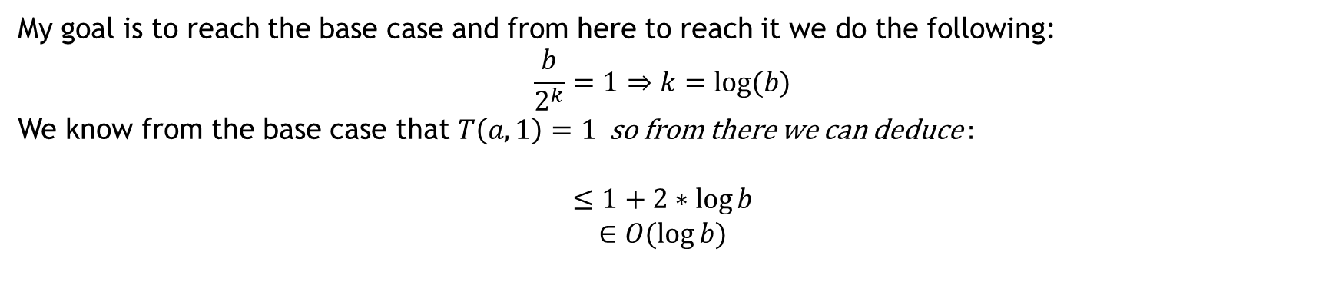
My goal is to reach the base case and from here to reach it we do the following:
$$\frac{b}{2^{k}}=1⇒k=log⁡(b)$$
We know from the base case that $T\left(a,1\right)=1$so from there we can deduce :
$$≤1+2∗\log{b}$$
$$∈O(\log{b)}$$

